Slide 1
Analysis of 7+ Million Company Dataset
By Nikul Kerai

Slide 2
About Dataset
Generated in 2019 by People Data labs
Contains 7+ million global companies
From 237 + countries
Company sizes ranging from 1-10000+
Contains information about global companies such as names, domains, sizes, years founded, industries, localities, countries and LinkedIn URLs

Slide 3
Purpose & Objectives
Purpose: Gain useful insights to understand how companies are dispersed worldwide
Objectives: Identify key trends in the dataset from country to country

Slide 4
Data Preparation & Cleaning
Load necessary Python libraries and the dataset.
Pre-process the dataset so that I primarily focused on the columns of the data that I would be analysing and then dropped the columns that I would not be analysing.
Found out how much data was missing from different variables such as year founded, country, industry and locality.
Created a modified csv with a small proportion of the dataset, choosing to analyse only 10000 rows of the data and then used this sample of the data to create visualisations of the data in different ways.

Slide 5
Questions to Answer about the Data
Q1) What is the distribution of the companies like over the years?
Q2) What is the distribution of the industries like over the years?
Q3) What country has the highest total employee estimate?
Q4) What country has the highest current employee estimate?
Q5) What industry has the highest distribution globally as a percentage?
Q6) What country has the highest percentage of distributed industries?

Slide 6

Exploratory Data Analysis & Visualisation

Slide 7
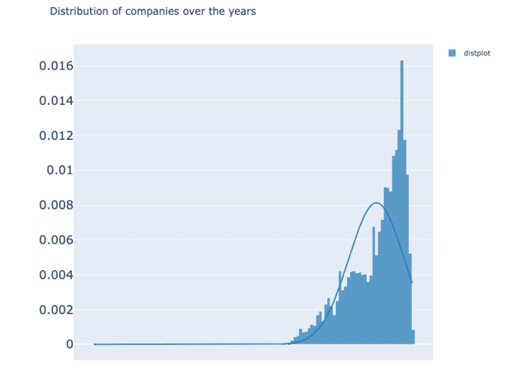
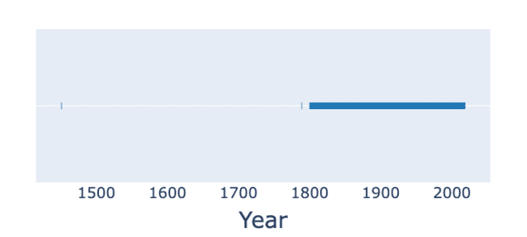
Q1) What is the distribution of the companies like over the years?
Most companies founded between 1946 and 2006 around the world

Slide 8
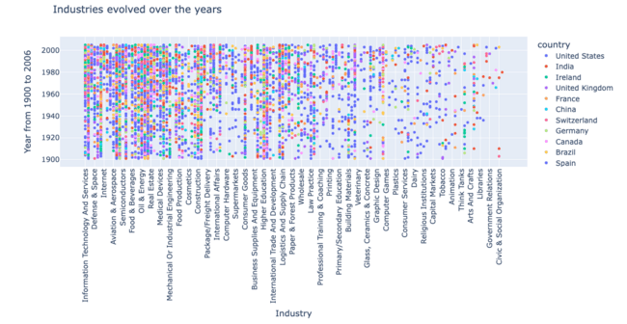
Q2) What is the distribution of the industries like over the years?
Some industries took longer to become established in different countries whereas the higher education industry was one of the industries which developed rapidly over different countries.

Slide 9
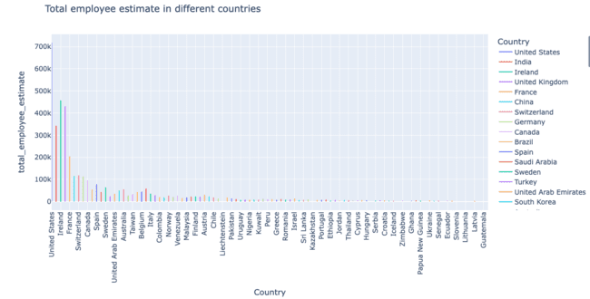
Q3) Which country had the highest total employee estimate?
Ireland

Slide 10
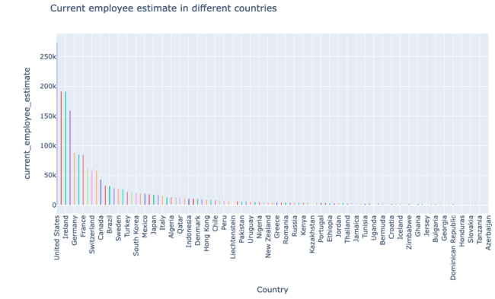
Q4) Which country had the highest current employee estimate?
United States

Slide 11
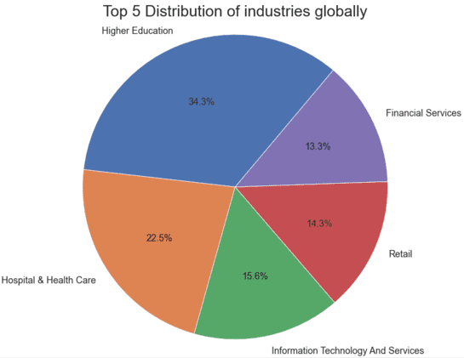
Q5) Which industry has the highest distribution globally as a percentage?
Higher Education at 34.3%

Slide 12
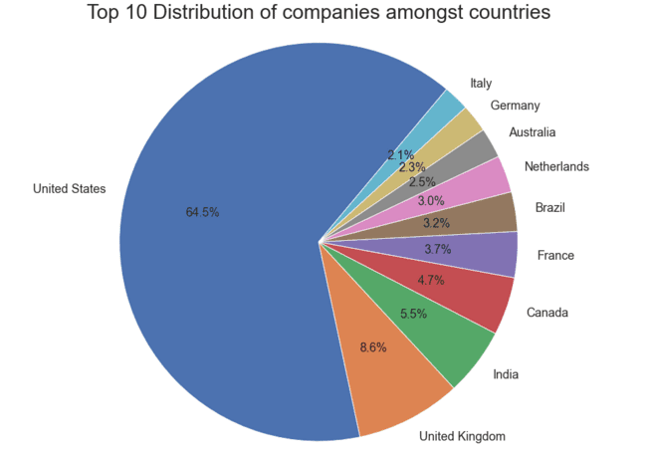
Q6) Which country has the highest percentage of distributed industries?
United States 64.5%

Slide 13
Conclusions & Future Work
Conclusions
Majority of the companies established between 1946 and 2006 around the world.
Most companies established in the United States followed by the UK and India.
Education industry is the majority contributor worldwide.
Future Work
Analyse the whole dataset to see if the same trends and insights are seen in the whole dataset in comparison to the 10000 rows analysed.
Visualise cities where the industries are located around the world.
Stratified sampling for every country.
Obtain and analyse data about China companies as this is missing from this dataset.

